Slide 1
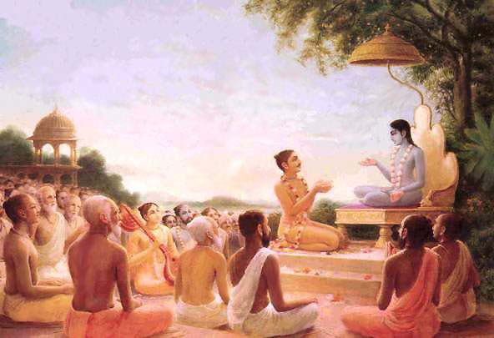
Śrīmad Bhāgavatam
1.14.35–44
Yudhiñöhira Maharaja Inquires Arjuna

Slide 2
SB 1.2.4
nārāyaṇaḿ namaskṛtya
naraḿ caiva narottamam
devīḿ sarasvatīḿ vyāsaḿ
tato jayam udīrayet

Slide 3
SB 1.2.18
naṣṭa-prāyeṣv abhadreṣu
nityaḿ bhāgavata-sevayā
bhagavaty uttama-śloke
bhaktir bhavati naiṣṭhikī

Slide 4
Recap
1-21: Inauspicious omens observed by Yudhisthira Maharaja
22-34: Arujna returns from Dwaraka and Yudhisthira Maharaja’s inquiry
Notes:
Seasonal changes, people in general greedy, angry, deceitful
Very dejected , Inquires about Lord’s relatives and friends

Slide 5
Outline
14.35-37: Serving the Lotus feet of the Lord
38: Lord’s Protection - fearlessness
39-43: Prescribed duties of a good King
44: Only one reason for Arjuna’s acute dejection
Notes:
Yadus have showed the example
How devotees can feel protected
Not following causes for despondency
YM finally mentions the reason dejection

Slide 6
SB 1.35-36
maìgaläya ca lokänäà
kñemäya ca bhaväya ca
äste yadu-kulämbhodhäv
ädyo 'nanta-sakhaù pumän
yad bähu-daëòa-guptäyäà
sva-puryäà yadavo 'rcitäù
kréòanti paramänandaà
mahä-pauruñikä iva
The original Personality of Godhead, the enjoyer, and Balaräma, the primeval Lord Ananta, are staying in the ocean of the Yadu dynasty for the welfare, protection and general progress of the entire universe. And the members of the Yadu dynasty, being protected by the arms of the Lord, are enjoying life like the residents of the spiritual sky.
Notes:
Instead of inquiry, YM statements about Lord’s glories

Slide 7
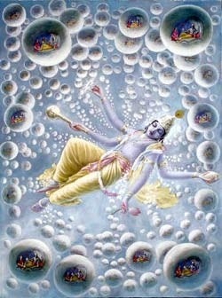
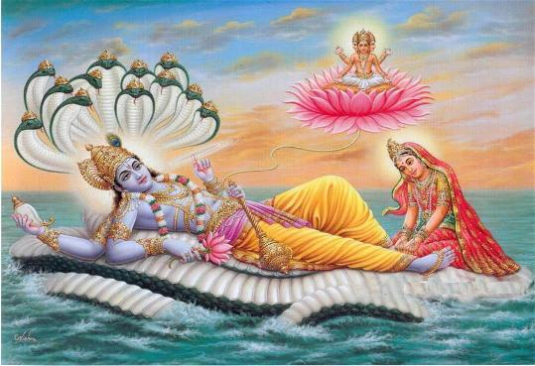
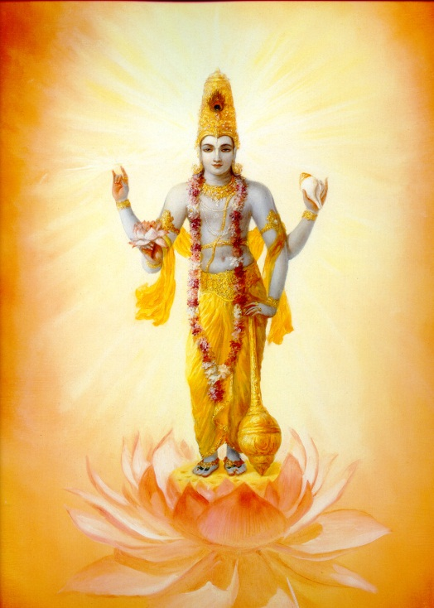
SB 1.35-36
Lord Viñëu resides within universe in two capacities –
Garbhodakaçäyé Viñëu and the Kñérodakaçäyé Viñëu
Comparision
Yadu dynasty to the ocean of milk
Çré Balaräma to the Ananta
citizens of Dvärakä to inhabitants of the Vaikuëöhalokas
Notes:
northern top of the universe, and there is a great ocean of milk where the Lord resides on the bed of the Ananta

Slide 8
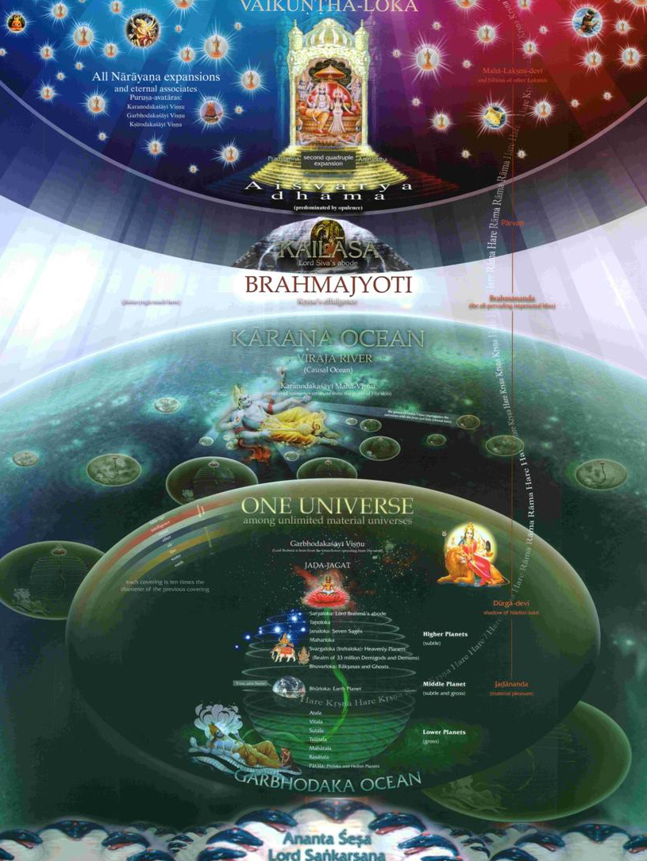
Vaikuëöha planets
the Lord
Notes:
earth, water, fire, air, sky, the total energy and false ego — 10 times
Casual ocean- universes are floating like footballs,
, brahmajyoti – spirutual sky.. Millions of planets

Slide 9
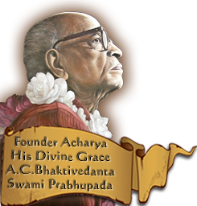
Mahä-pauruñikas - persons directly engaged in the service of
“They are happy in those planets and are without any kind of
misery, and they live perpetually in full youthfulness,
enjoying life in full bliss and knowledge
without fear of birth, death, old age or disease,
and without the influence of käla, eternal time.”
Notes:
YM compared the inhabitants of Dvärakä to the Mahä-pauruñikas of Vaikuntaloka because they are so happy with the Lord

Slide 10
SB 1.14.37
yat-päda-çuçrüñaëa-mukhya-karmaëä
satyädayo dvy-añöa-sahasra-yoñitaù
nirjitya saìkhye tri-daçäàs tad-äçiño
haranti vajräyudha-vallabhocitäù
Simply by administering comforts at the lotus feet of the Lord, which is the most important of all services, the queens at Dvärakä, headed by Satyabhämä, induced the Lord to conquer the demigods. Thus the queens enjoy things which are prerogatives of the wives of the controller of thunderbolts.
Notes:
Theme – serving the Lotus feet of the Lord with the best capacity we can. Example set by Satyabhama and Yadu members

Slide 11
Satyabhämä
pärijäta flower - Special prerogatives of the demigods in the
heavenly planets
Satyabhämä meeting Draupadé
Administering all comforts to the Lord
Lord got parijata flower by force to please Satyabhämä
Lord played the part of a faithful and complete husband
Cause of falldown - enjoyer of opulences
Lord is the proprietor of everything..creator and enjoyer
“since the Lord is the proprietor of everything within His
creation, it is not very astonishing for the queens
of Dvärakä to have any rare thing from
any part of the universe”
Notes:
Killing Narakäsura,
Vistied Indraloka to return things also with Satyabhämä,
Met mother of the demigods, Aditi ,
Satybhama decorated palace with valuable jewels.. air-conditioned, flags
common husband secures things to please wife.. doesn’t need to. They accepted the high quality of devotional service.. used all opulences His service
Isopanisad – isavasyam idam srvam – controlled and owned

Slide 12
SB 1.14.38
yad bähu-daëòäbhyudayänujévino
yadu-pravérä hy akutobhayä muhuù
adhikramanty aìghribhir ähåtäà balät
sabhäà sudharmäà sura-sattamocitäm
The great heroes of the Yadu dynasty, being protected by the arms of Lord Çré Kåñëa, always remain fearless in every respect. And therefore their feet trample over the Sudharmä assembly house, which the best demigods deserved but which was taken away from them.
Notes:
Do we want to be like that? Fearless b’coz they were always in service mood and used everything in Lord’s service

Slide 13
Direct servitors of the Lord – protected from fearfulness and
they enjoy the best of things.
Sudharmä - state assembly house
“Lord Kåñëa was provided with all kinds of comforts and
facilities available within the universe
by the members of the Yadu dynasty, and in return such
servitors of the Lord were protected and fearless.”
Notes:
Yadus were serving the lord directly. Pure devotees – Lord is equal to everyone but partial to pure devotees
Servants of king also enjoy opulences as king
human being on the earth is unable to construct it – even state is materially advanced

Slide 14
Our Constitutional position
na jäyate mriyate vä kadäcin – Neither Birth or Death
Cause of fear?
“Forgetfulness of our eternal relation with the Lord”
Example – Tiger in a dream
Conditoned soul/ liberated soul
“Thus the members of the Yadu dynasty were fully awake
in their service to the Lord, and therefore there
was no tiger for them to be afraid of at any time.
Even if there were a real tiger, the Lord was there
to protect them.”
Notes:
Bg 2.20 - neither birth nor death at any time.
forgetful of his awakened life is fearful, not forgotten his position is not at all fearful
Always fearful/ never fearful – child dependent on the mercy of the father

Slide 15
SB 1.14.39
kaccit te 'nämayaà täta
bhrañöa-tejä vibhäsi me
alabdha-mäno 'vajïätaù
kià vä täta ciroñitaù
My brother Arjuna, please tell me whether your health is all right. You appear to have lost your bodily luster. Is this due to others disrespecting and neglecting you because of your long stay at Dvärakä?
Notes:
Inquires about personal welfare – lost his bodily luster
YM –welfare of Dvärakä - concludes nothing inauspicious can happen

Slide 16
SB 1.14.40
kaccin näbhihato 'bhävaiù
çabdädibhir amaìgalaiù
na dattam uktam arthibhya
äçayä yat pratiçrutam
Has someone addressed you with unfriendly words or threatened you? Could you not give charity to one who asked, or could you not keep your promise to someone?
“When they are asked for a donation, it is the duty of the
possessor of wealth to give in charity in consideration
of the person, place and time..”
Notes:
This section – duties/qualities of a ksatriya
Any examples from SB – Drupada & Dronacarya – cause of downfall, kept promise –Maharaja Khatvanga, long fast
HVP – person standing on the ramp – 148th st

Slide 17
SB 1.14.41
kaccit tvaà brähmaëaà bälaà
gäà våddhaà rogiëaà striyam
çaraëopasåtaà sattvaà
nätyäkñéù çaraëa-pradaù
You are always the protector of the deserving living beings, such as brähmaëas, children, cows, women and the diseased. Could you not give them protection when they approached you for shelter?
“If such living beings do not get
protection by the kñatriya, or the royal order, or by the
state, it is certainly shameful for the kñatriya or the state.”
Notes:
Emphasizing protection

Slide 18
SB 1.14.42
kaccit tvaà nägamo 'gamyäà
gamyäà väsat-kåtäà striyam
paräjito vätha bhavän
nottamair näsamaiù pathi
Have you contacted a woman of impeachable character, or have you not properly treated a deserving woman? Or have you been defeated on the way by someone who is inferior or equal to you?
Notes:
Contact between man and women, ksatriya

Slide 19
Brähmaëas, kñatriyas → woman of the vaiçya, çüdra community
Not allowed
Lower community → Higher community
Seven mothers - one's own mother,
wife of the spiritual master, brähmaëa, king
cow, nurse, earth
Uttama - contact of a brähmaëa with a kñatriya woman. ex-Vyäsadeva, Paräçara muni
Adhama - contact of a kñatriya with a brähmaëa woman. ex-Romaharsana Suta’s father
Inferior or equal in strength, superior power
Examples – Bhéñmadeva, Karëa
Kali-yuga – no samskaras.. No application of these points
“Contact between man and woman is natural, but that also
must be carried out under regulative principles so that
social consecration may not be disturbed or unwanted
worthless population be increased for the unrest of the world.”
Notes:
free contact between man and woman was allowed in certain conditions only
Other examples – Bhéma, Yayäti,
Romaharsana Suta - his father was a ksatriya and his mother a brahmana – offended Balaram
abominable for a ksatriya to be defeated by one who is
varnasankara

Slide 20
SB 1.14.43
api svit parya-bhuìkthäs tvaà
sambhojyän våddha-bälakän
jugupsitaà karma kiïcit
kåtavän na yad akñamam
Have you not taken care of old men and boys who deserve to dine with you? Have you left them and taken your meals alone? Have you committed some unpardonable mistake which is considered to be abominable?

Slide 21
Householder/Ideal Householder
“The neglect of this prescribed duty of a householder, especially in the matter of the old men and children, is unpardonable..”

Slide 22
SB 1.14.44
kaccit preñöhatamenätha
hådayenätma-bandhunä
çünyo 'smi rahito nityaà
manyase te 'nyathä na ruk
Or is it that you are feeling empty for all time because you might have lost your most intimate friend, Lord Kåñëa? O my brother Arjuna, I can think of no other reason for your becoming so dejected.
Acute dejection
We feel it too..
Notes:
Not possible otherwise
all comforts b’coz we have lost the relationship with the Lord

Slide 23
Summary
Feel protection/fearlessness only under the shelter of Lord’s lotus feet
Cause of falldown – If we think we are the enjoyer
Duties of a householder – charity, taking care of family
Want to be happy – establish loving relationship with Kåñëa
Fear – “forgetfulness of Kåñëa”
Notes:
Needs of family

Slide 24
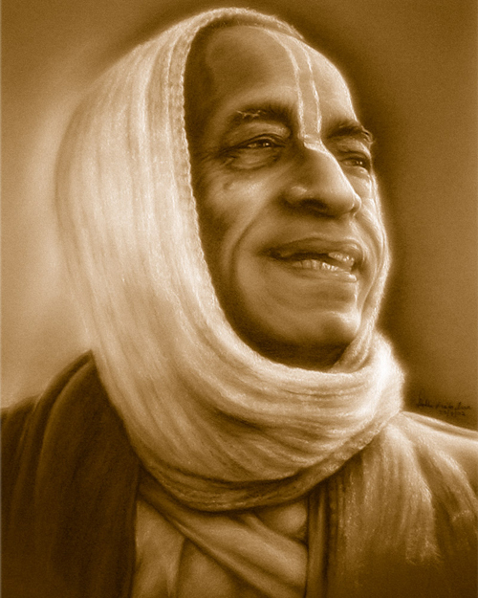
References
HH Romapada Swami Maharaj’s SB Lecture
Unveiling His Lotus feet – HG Bhurijana prabhu

